Slide 1
R Programming Language
Dr. Supriya Chakraborty

Slide 2
What is R?
R is a popular programming language used for statistical computing and graphical presentation.
Its most common use is to analyze and visualize data.

Slide 3
Why Use R?
It is a great resource for data analysis, data visualization, data science and machine learning
It provides many statistical techniques (such as statistical tests, classification, clustering and data reduction)
It is easy to draw graphs in R, like pie charts, histograms, box plot, scatter plot, etc++
It works on different platforms (Windows, Mac, Linux)
It is open-source and free
It has a large community support
It has many packages (libraries of functions) that can be used to solve different problems

Slide 4
Installation Guide Rstudio
Download R Studio Latest version according to your machine configuration (32/64) bits
The link to download Download the RStudio IDE – Rstudio
Download the Rsudio Desktop Version and install.

Slide 5
Installation of R compiler
Start Rstudio and according to instruction move to the original R compiler site at R: The R Project for Statistical Computing (r-project.org)
Click on the CRAN and then
Click on https://cloud.r-project.org/
Click on Download R for Windows
Download and Install
Start once again the Rstudio

Slide 6
Print String
“Hello World ”

Slide 7
Operation
5 + 5
5 – 5
5 * 5
5 / 5

Slide 8
For loop
for (x in 1:10) { print(x) }
Output
[1] 1
[1] 2
[1] 3
[1] 4
[1] 5
[1] 6
[1] 7
[1] 8
[1] 9
[1] 10

Slide 9
Comment in R
# This is a comment "Hello World!"

Slide 10
Creating Variables in R
Variables are containers for storing data values.
R does not have a command for declaring a variable. A variable is created the moment you first assign a value to it. To assign a value to a variable, use the <- sign. To output (or print) the variable value, just type the variable name:
name <- "John" age <- 40 name # output "John" age # output 40
In other programming language, it is common to use = as an assignment operator. In R, we can use both = and <- as assignment operators.

Slide 11
Concatenate
text1 <- "R is" text2 <- "awesome" paste(text1, text2)
num1 <- 5 num2 <- 10 num1 + num2
If you try to combine a string (text) and a number, R will give you an error:

Slide 12
Built in Math Function
max(5, 10, 15) min(5, 10, 15)

Slide 13
Other built0in function
sqrt(16)
abs(-4.7)
ceiling(1.4)
floor(1.4)

Slide 14
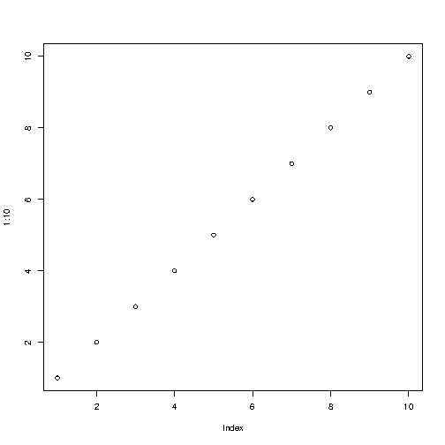
Data Visualization
# We need this line of code to show graphs in our compiler
bitmap(file="out.png")
# Plot numbers from 1 to 10 on the graph
plot(1:10)

Slide 15
Function in R
my_function <- function() { # create a function with the name my_function print(“Function Definition in R!") }
my_function() # call the function named my_function

Slide 16
Experiment 1: Quadratic Equation (one variable)
f(x) = ax² + bx + c =0where a, b, c, ∈ R and a ≠ 0.
A is called leading coefficient
C is called absolute term
Quadratic equation always has two roots (α,β)
Notes:
It is the general form of a quadratic equation where ‘a’ is called the leading coefficient and ‘c’ is called the absolute term of f (x). The values of x satisfying the quadratic equation are the roots of the quadratic equation (α,β).

Slide 17
Roots of the quadratic equation
Roots = [-b ± √(b² – 4ac)] /2a
The nature of root depends of on the discriminant(D) b² – 4ac
D > 0, roots are real and distinct (unequal)
D = 0, roots are real and equal (coincident)
D < 0, roots are imaginary and unequal

Slide 18
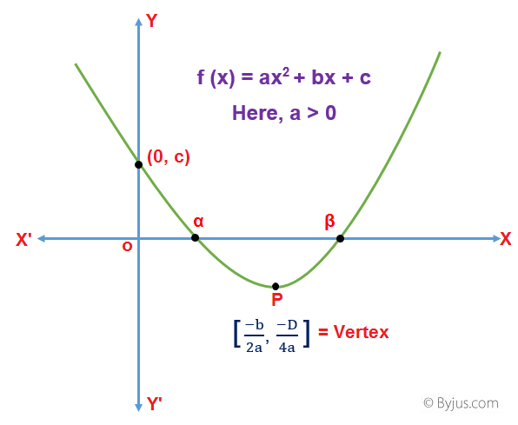
Infographics
The root touches the x-axis either at two points when D> 0,
The root just touches the x-axis in one point when D= 0
The root never touches the x-axis when D < 0

Slide 19

Application of Quadratic Equation
To find the speed of the Object
To find the profit of product
Areas of rooms
Single variable multiple once

Slide 20
Implement
WAP to find the root of quadratic equation in R.
Notes:
# https://dk81.github.io/dkmathstats_site/rmath-quad-formula-r.html
# Quadratic Formula In R: # Reference: http://stackoverflow.com/questions/15589601/print-string-and-variable-contents-on-the-same-line-in-r # Quadratic equation form of ax^2 + bx + c # Create quadratic formula function: quadraticRoots <- function(a, b, c) { print(paste0("You have chosen the quadratic equation ", a, "x^2 + ", b, "x + ", c, ".")) discriminant <- (b^2) - (4*a*c) if(discriminant < 0) { return(paste0("This quadratic equation has no real numbered roots.")) } else if(discriminant > 0) { x_int_plus <- (-b + sqrt(discriminant)) / (2*a) x_int_neg <- (-b - sqrt(discriminant)) / (2*a) return(paste0("The two x-intercepts for the quadratic equation are ", format(round(x_int_plus, 5), nsmall = 5), " and ", format(round(x_int_neg, 5), nsmall = 5), ".")) } else #discriminant = 0 case x_int <- (-b) / (2*a) return(paste0("The quadratic equation has only one root. This root is ", x_int)) }

